Slide 1

Conclusion Validity
Anh Nguyen, Hanna Song

Slide 2
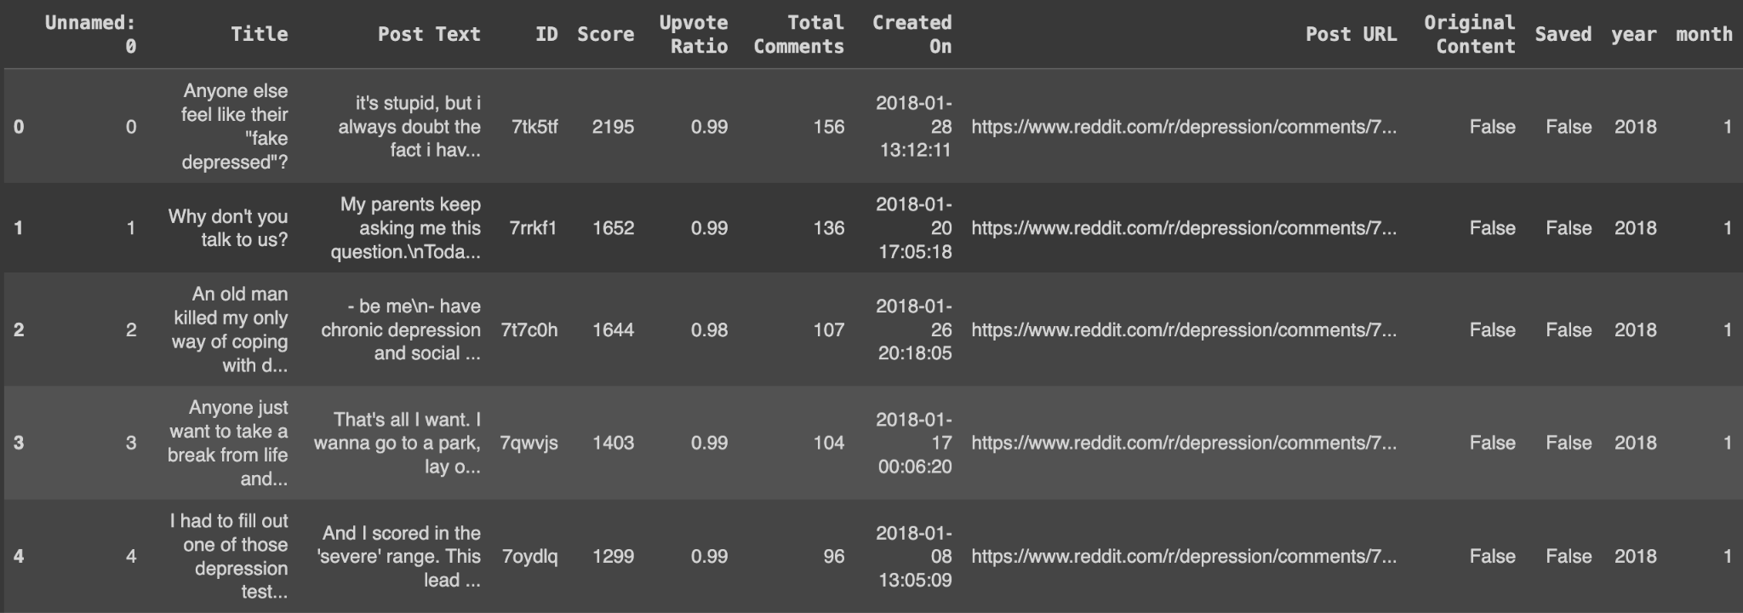
Updates on Pilot Data
9 subreddits related to mental illness, divided by pre-COVID and post-COVID
Collecting monthly top posts with same timeframe (containing same variables)
Notes:
The pandemic has introduced various stressors and uncertainties, such as health concerns, economic instability, social isolation, and disruptions to daily routines. These stressors can contribute to increased levels of anxiety, fear, and emotional distress among individuals.
Subreddits dedicated to mental health-related topics provide online platforms for individuals to seek information, share experiences, and seek support from others facing similar challenges. These communities often serve as safe spaces for individuals to express their thoughts, emotions, and concerns related to mental health.

Slide 3
Independent/Dependent Variables
Independent variables: Post Text, User ID, Number of Comments, Score, Upvote Ratio
Dependent variables: Post trend and engagements
Relationship: Causal relationship between independent variables and each dependent variables

Slide 4
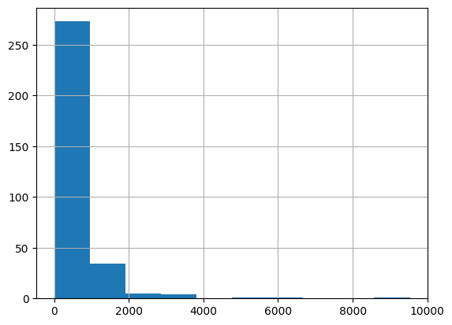
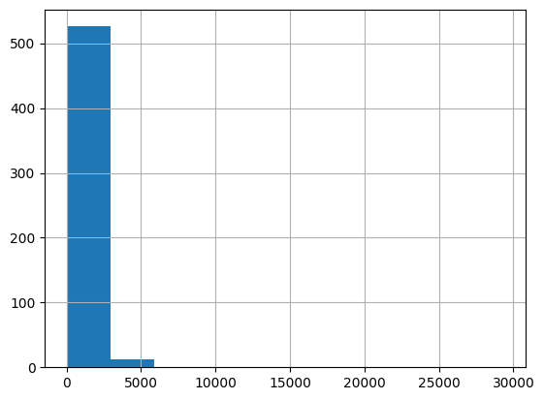
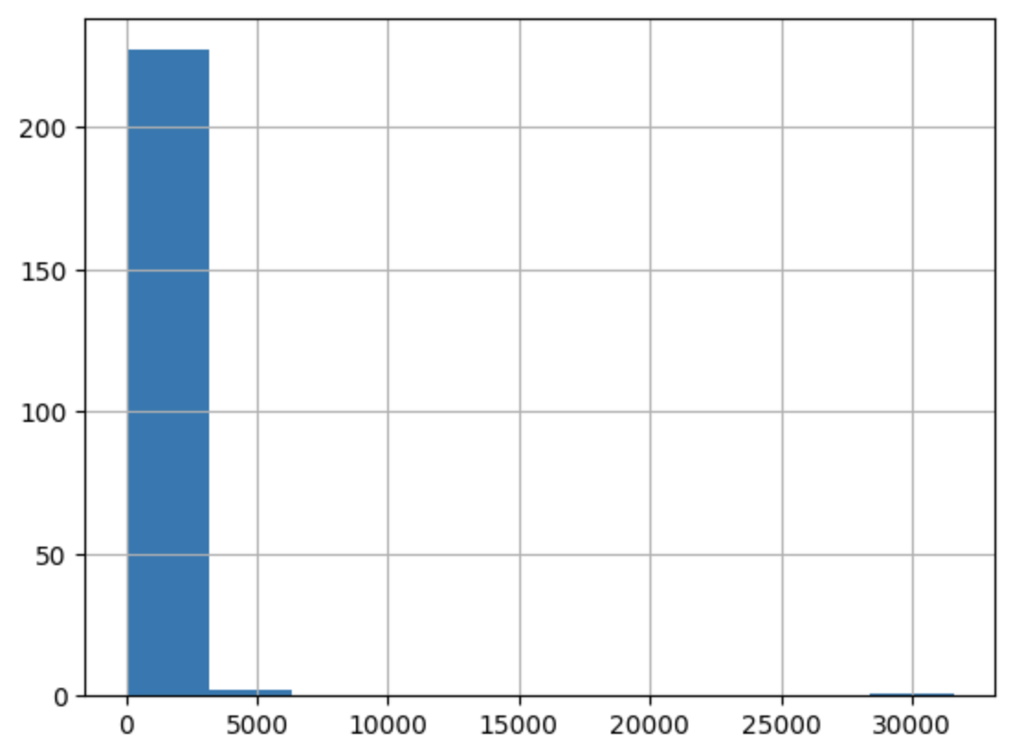
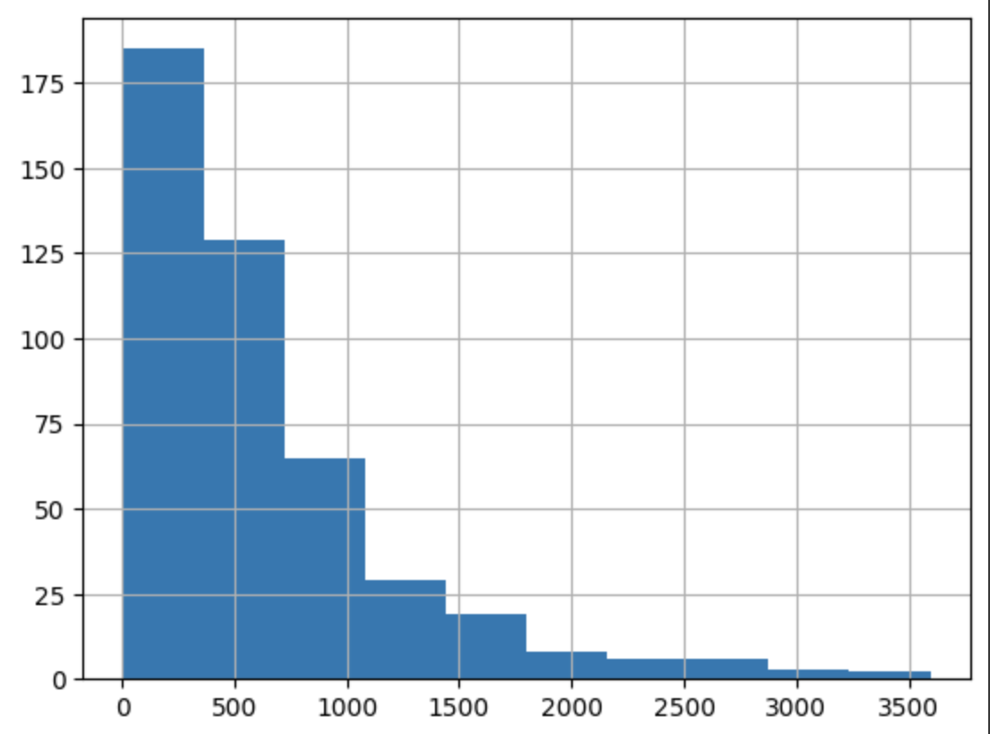
Descriptive Statistics in Pilot Data
(Depression and Anxiety subreddits)
Histogram of Post Length in Depression subreddit Pre-COVID vs Post-COVID
Histogram of Post Length in Anxiety subreddit Pre-COVID vs Post-COVID
Notes:
need to explain why no num of posts — limited to 1000 posts to scrap so we decide to use top posts which is already on trending

Slide 5
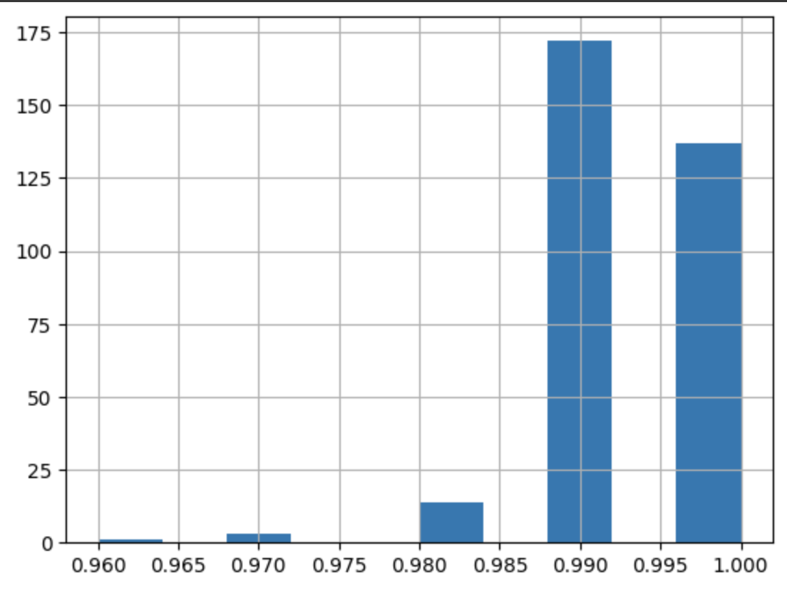
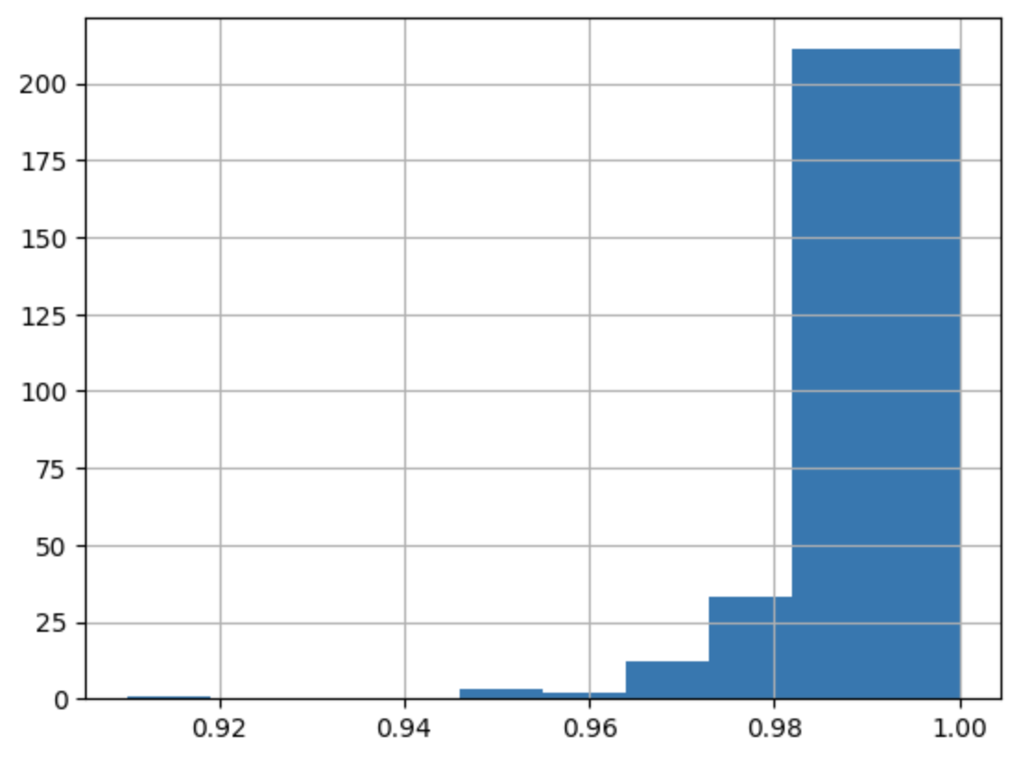
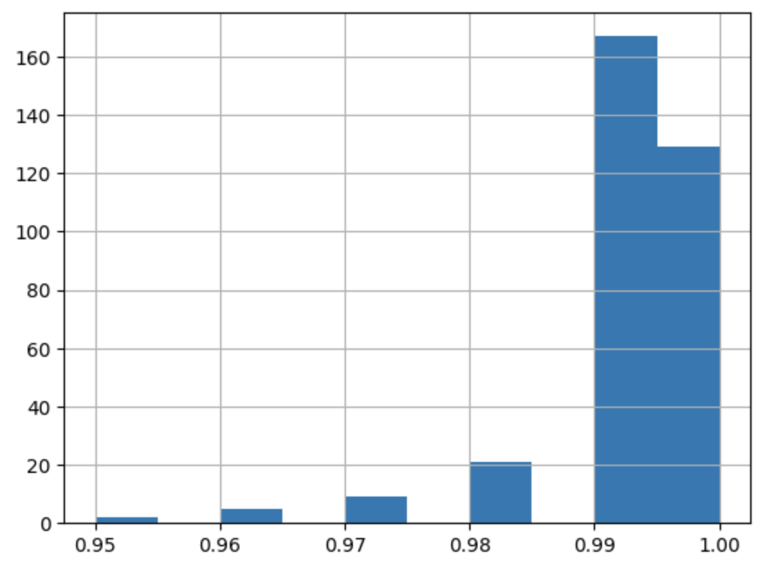
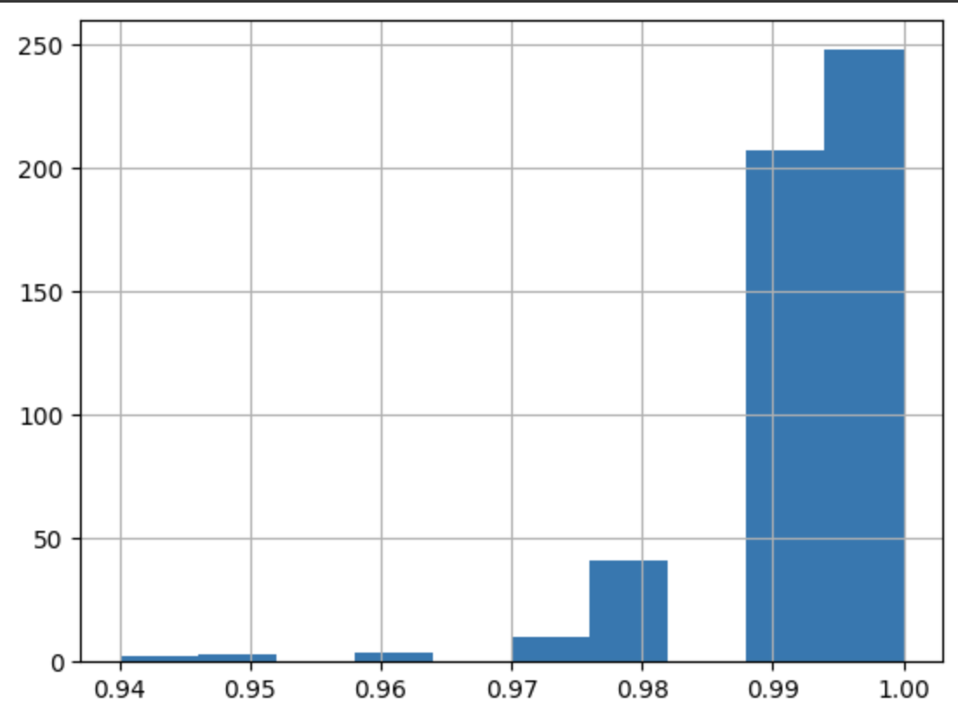
Descriptive Statistics in
Pilot Data
Histogram of Upvote Ratio in Depression subreddit Pre-COVID vs Post-COVID
Histogram of Upvote Ratio in Anxiety subreddit Pre-COVID vs Post-COVID
Notes:
need to explain why no num of posts — limited to 1000 posts to scrap so we decide to use top posts which is already on trending

Slide 6
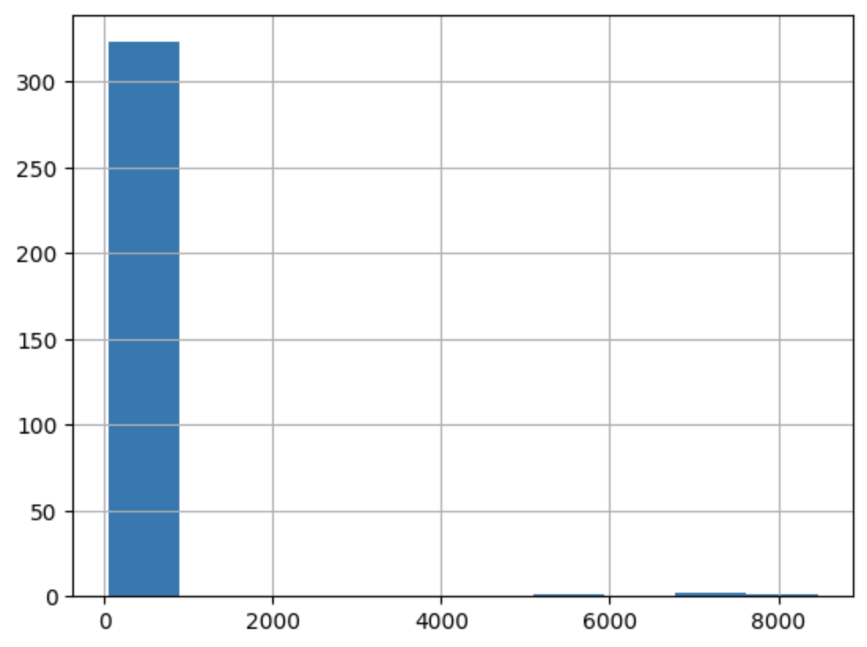
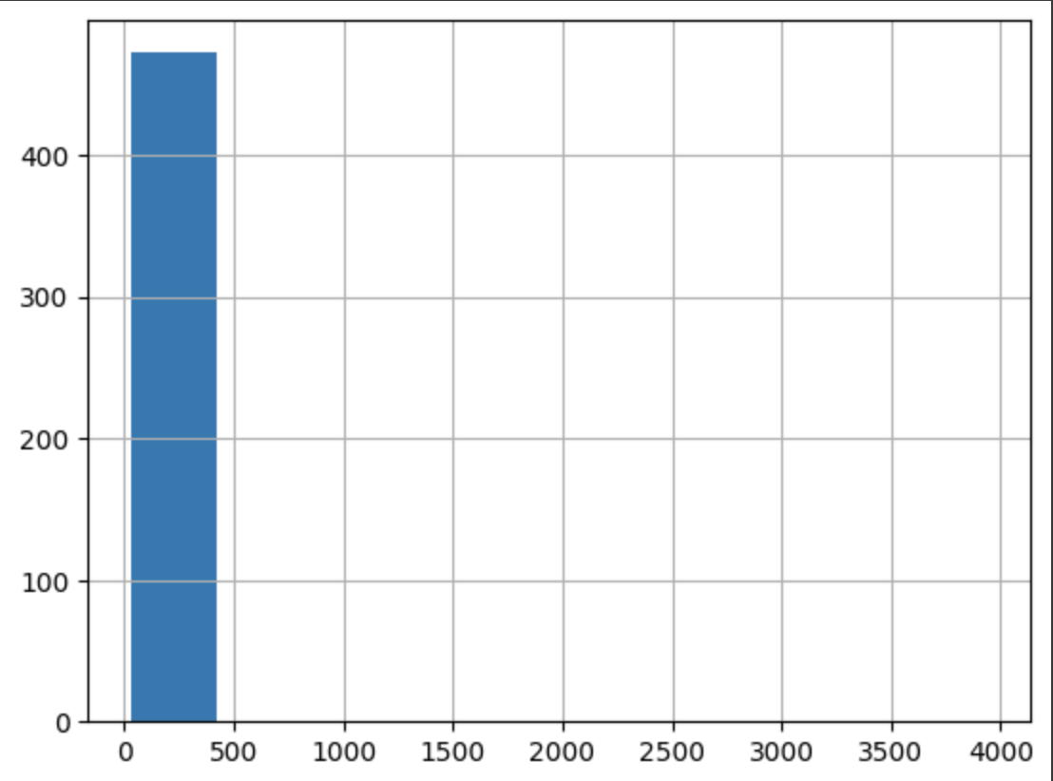
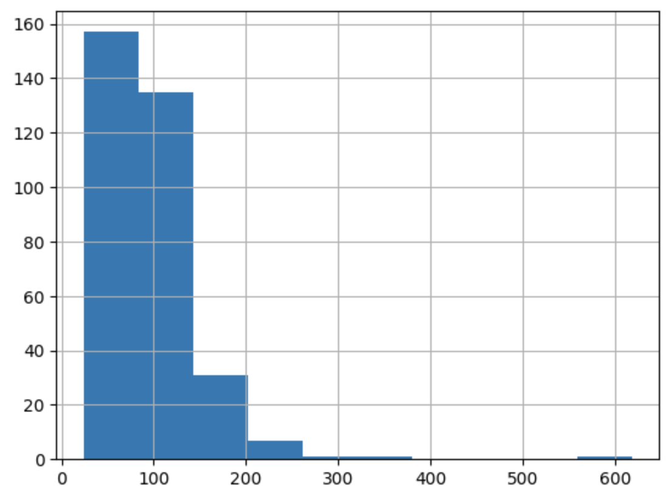
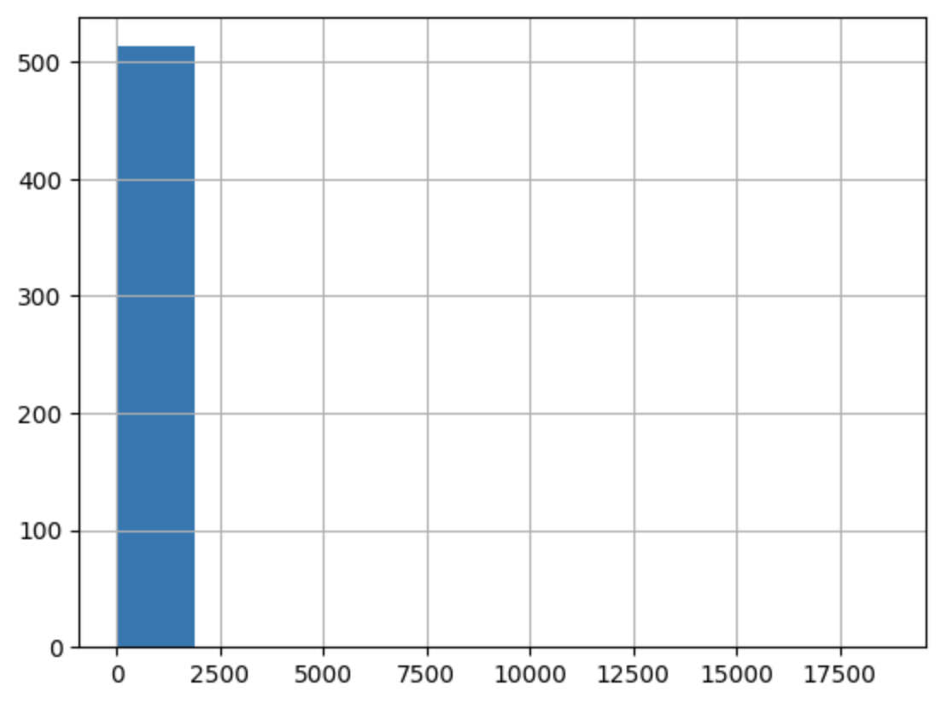
Descriptive Statistics in
Pilot Data
Histogram of Total Comments in Depression subreddit Pre-COVID vs Post-COVID
Histogram of Total Comments in Anxiety subreddit Pre-COVID vs Post-COVID

Slide 7
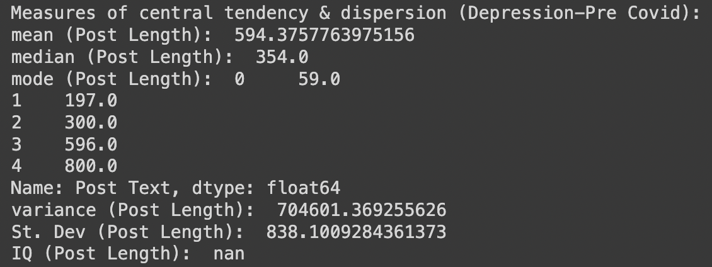
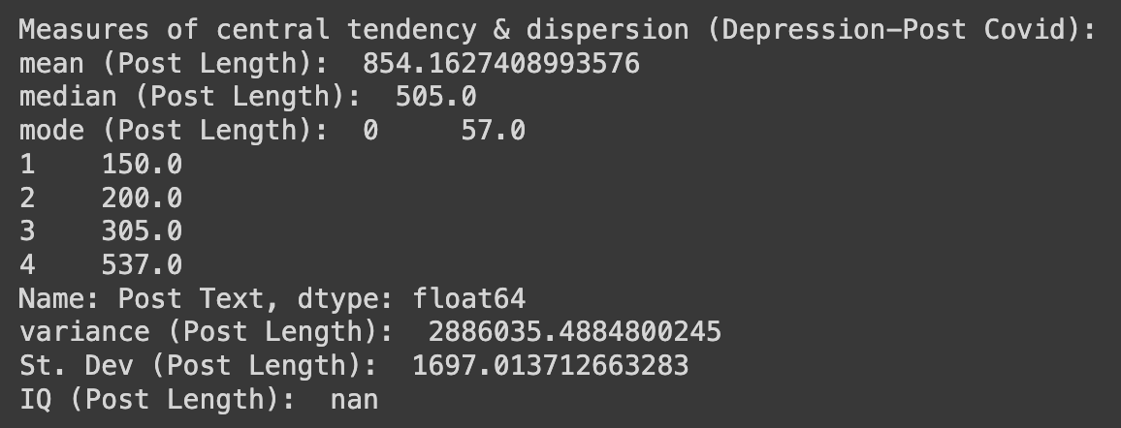
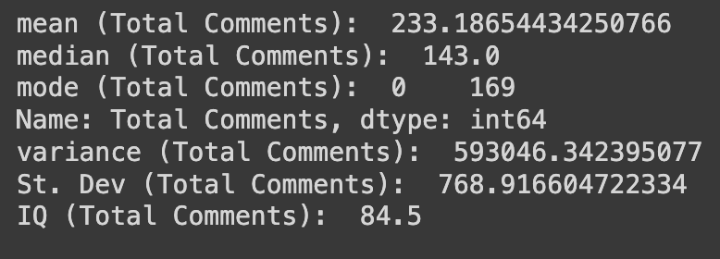
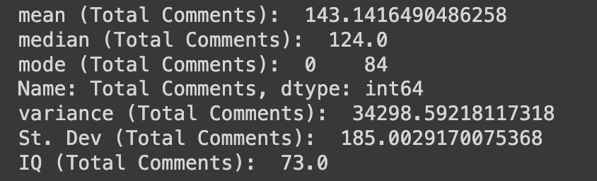
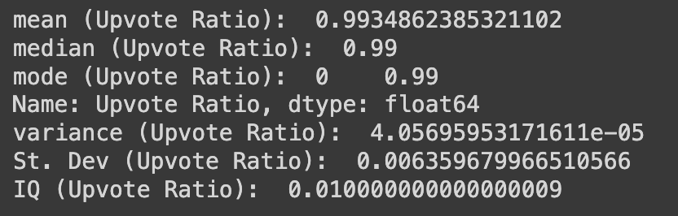
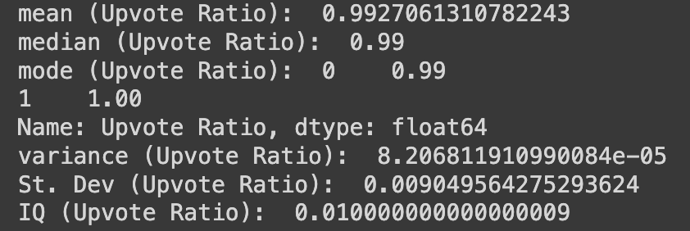
Central Tendency and Dispersion
Sample: Pre-COVID and Post-COVID Dataset from Depression subreddit
Pre-COVID Post-COVID
Notes:
we're mainly using these variables for the rest of our project, but we're also looking into incorporating other variables to make up a more concrete number of engagements outcome

Slide 8
Statistical Analysis
Statistical Analysis approach
t-test : Compare mean of variables pre vs post posts - numerical
Post length, number of comments from 9 subreddits
Two tails - power: 0.8
Null hypothesis: post trends change
Alternative: post trends not change
ANCOVA (adjusting time covariate)
Mean of post length and number of comments in 9 subreddits
ML Analysis approach (future)
Chi-square test - categorical
Topic modeling using post text → topics

Slide 9
Data Transformation
Data Transformation on Pilot Data
Post text → Post length
Future plan: Post text → topic modeling (LDA)
Chosen Statistical/ML model:
Post length → t-test , ANCOVA
Future plan : Post text → chi-square

Slide 10
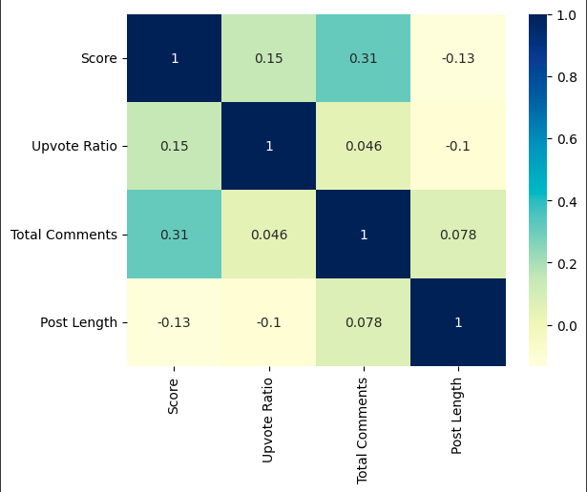
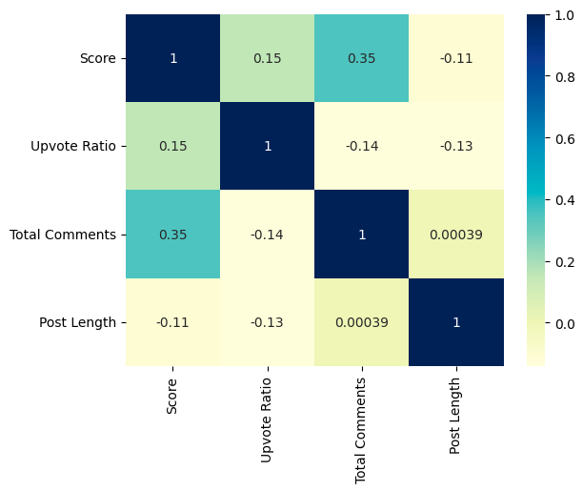
Correlational Method
Pearson's Correlation on log data
Pre-COVID
Post-COVID
Continuous Normal Distribution
Assume a linear relationship between upvote ratio, score and total comments
Ratio Data

Slide 11
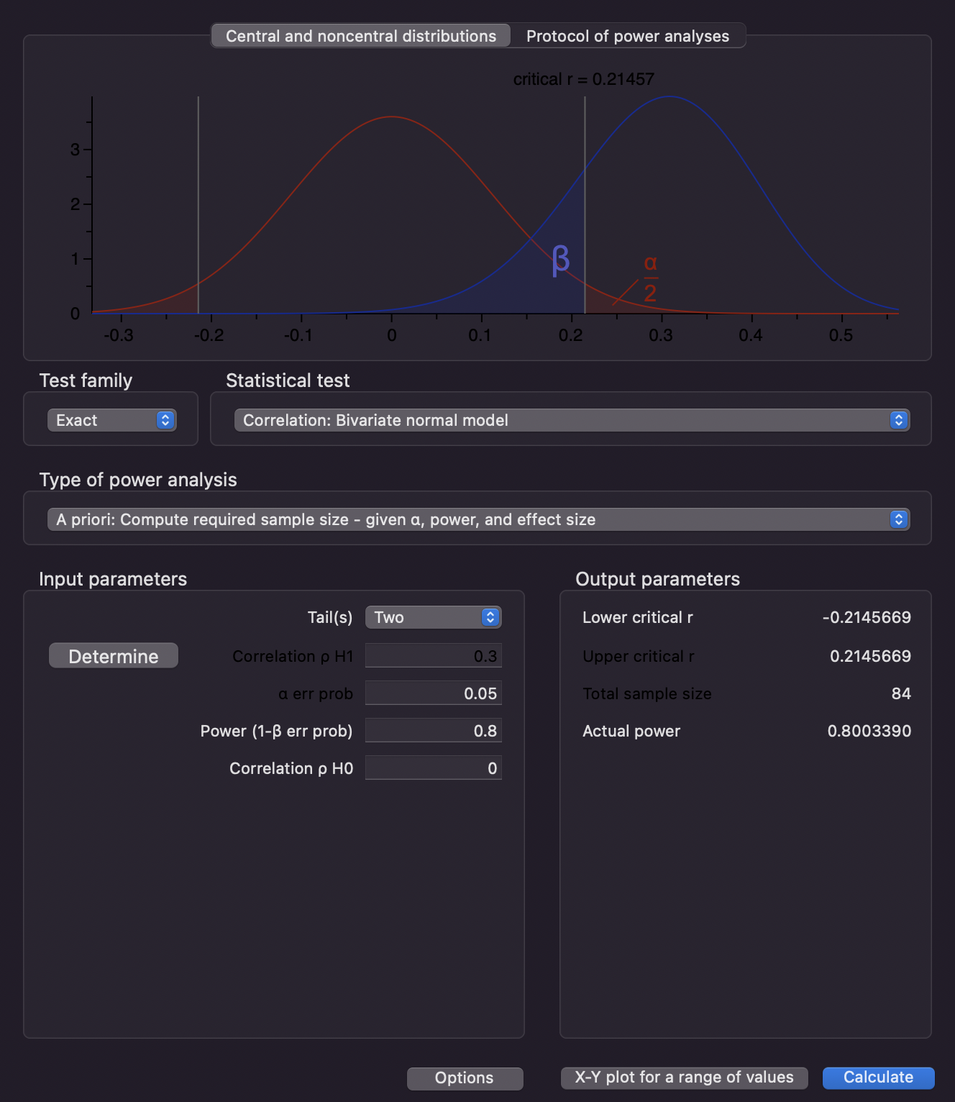
Correlational Method
Correlational Method we are using :
Correlation bivariate normal model
Continuous normally distributed → Pearson r
Post length & num of comments - positive corr.
Two-tailed with effect size of 0.3 -> medium
Power of 0.8 -> 80% significant
Result of total sample size : 84
Future plan: Correlation between probability of topics and post engagements → Pearson and Spearman

Slide 12
Covariates
Covariates
Time variable
Demographic/Characteristics of users
External factors
Control the time variable covariate
Scraping the same length of time frame - 2 years of pre and 2 years of post covid
Scraping post by months for all 9 subreddits

Slide 13
Analyses
Generalized Linear Model
t test with alpha of 0.05 (type 1 error rate) and power of 0.8
Nonequivalent group analysis
ANCOVA - separate groups are 9 subreddits
alpha of 0.05 and power of 0.8
Notes:
to control multiple comparison

Slide 14
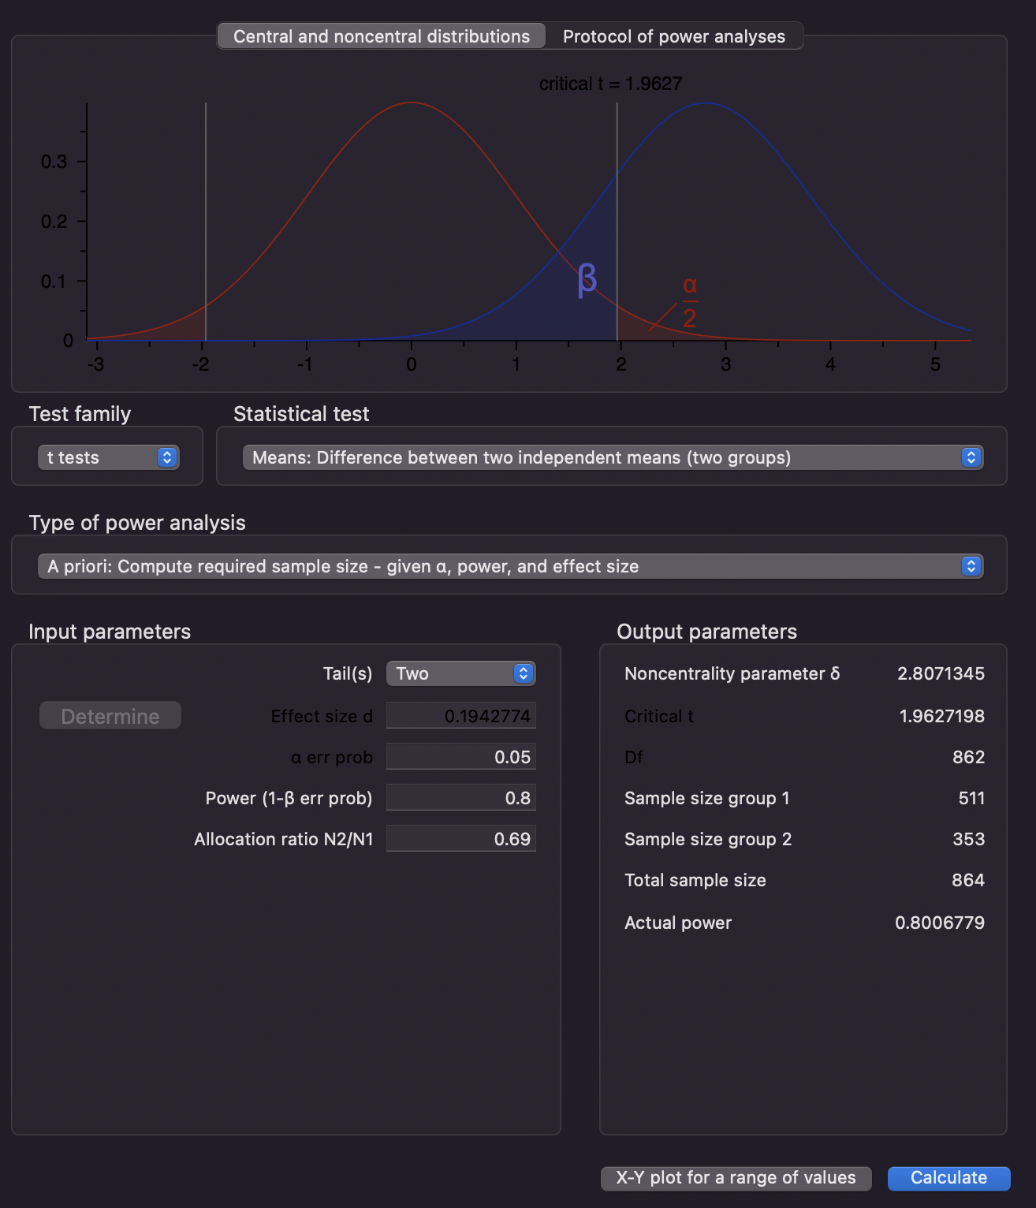
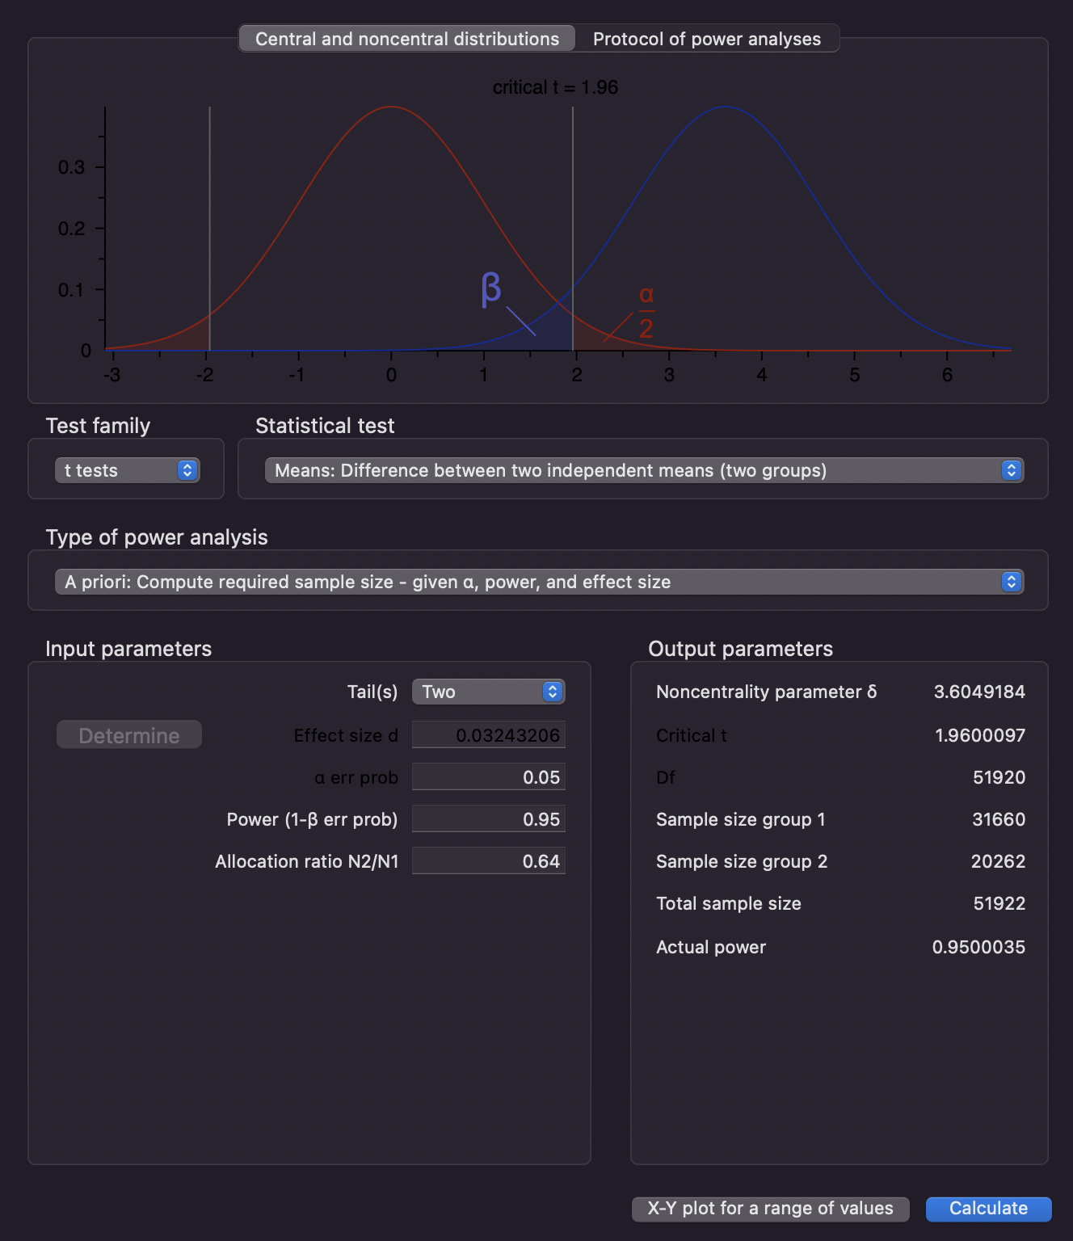


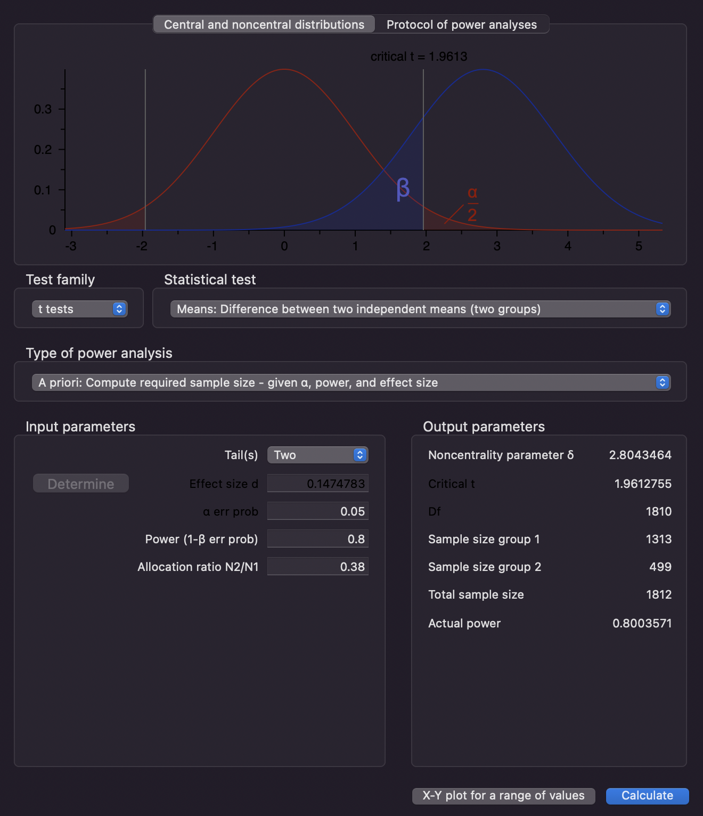
t-test on Pilot Data
Sample: Post length from each subreddit
Depression
Anxiety
ADHD
PTSD
Eating disorder

Slide 15
t-test on Pilot Data
Sample: t-test of Post length from Depression subreddit
t-test for comparing means of continuous variables
Conducted on two timeframes (pre-COVID and post-COVID):
Expected total sample size: 864
Two-tailed
Effect size from: mean and st. dev of post length – each pre & post-COVID Depression subreddit
Power of 0.8
Allocation ratio of N2/N1
Notes:
An a priori analysis is a sample size calculation performed before conducting the study and before the design and planning stage of the study; thus, it is used to calculate the sample size N, which is necessary to determine the effect size, desired α level, and power level (1-β). As an a priori analysis provides a method for controlling type I and II errors to prove the hypothesis, it is an ideal method of sample size and power calculation.

Slide 16
ANCOVA on Subreddit Groups
Factor
COVID
9 subreddit datasets
post engagement
post trends
Covariate
Time (adjusted by same timeframe pre and post COVID)
Categorical to Continuous variables with Covariates

Slide 17
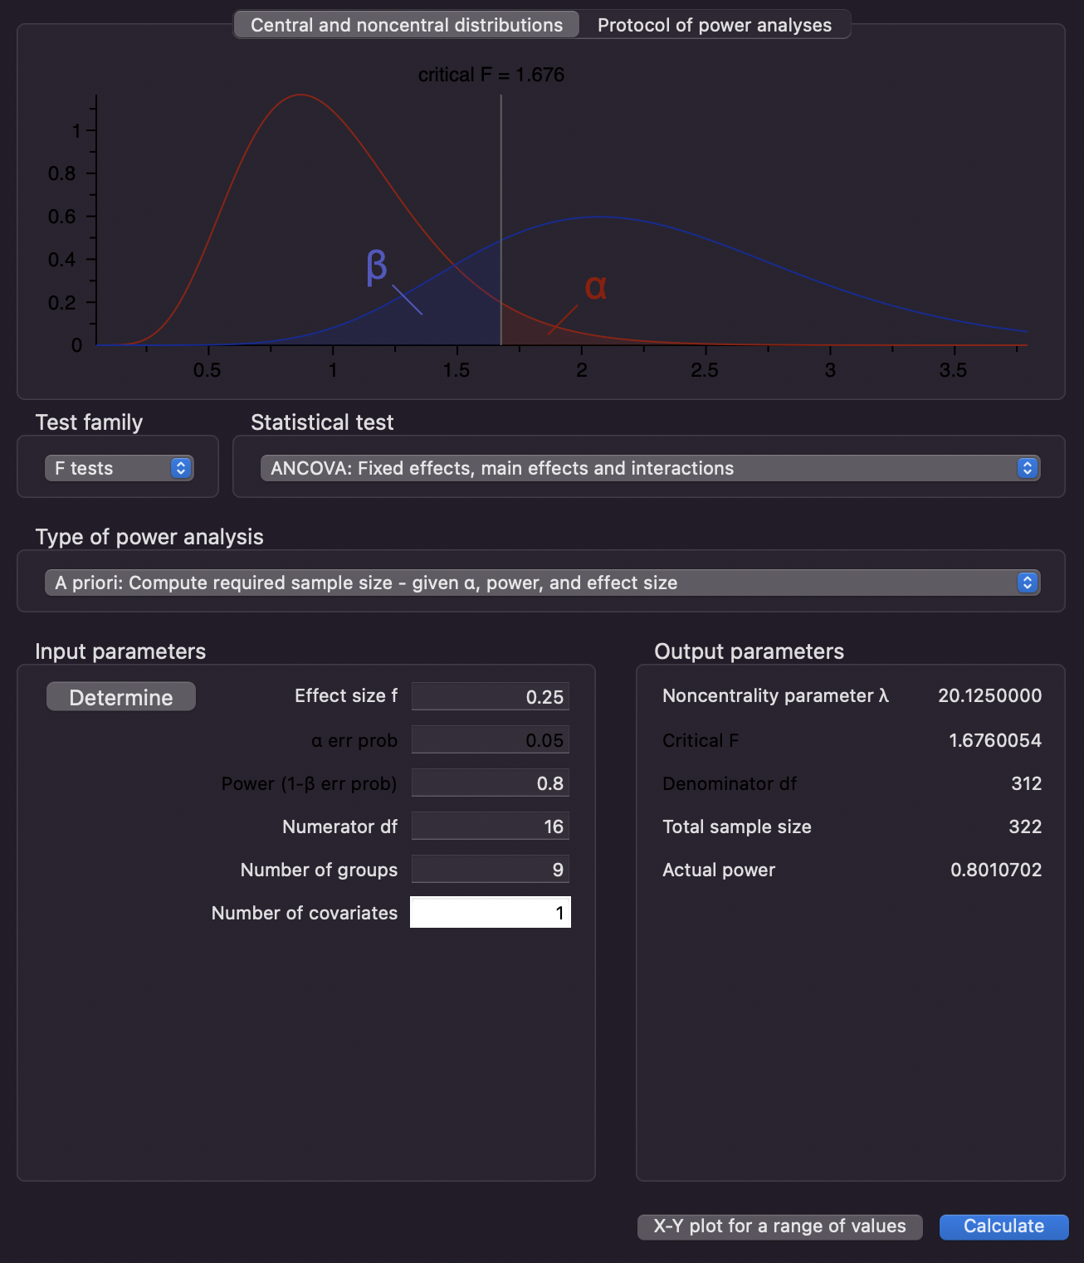
ANCOVA on Pilot Data
Effect size of 0.25 (moderate)
df = (2-1)(3-1)(9-1) = 16
Number of groups = 9
Number of covariates = 1
Result in total sample size of 322

Slide 18
Plan Summary
Question: Does COVID affect post trends from mental illness related subreddits?
Sampling Strategy:
Purposive Sampling: datasets from 9 mental health-related subreddits
Cluster Random Sampling: Uniform data from 2018 to 2020 and 2020 to 2022
Measurement Strategy:
Collect monthly data directly from reddits and use Python to transform necessary data
Analyze features according to their data types and units of analysis
Ensure that the data collection and cleaning processes are accurate
Ensure that all measurements adhere to ethical guidelines and regulations.
Design: Time Series/Nonequivalent dependent variables
Analysis plan: Pearson’s Correlation, t test, and ANCOVA
Notes:
with this plan we are trying to generalize with using 9 different subreddits with mitigating all confound variables
we need to spend time on topic modeling for 9 subreddits and statistical analysis on 9 subreddits as well
from past reflect, not control and treatment for pre vs post but we are comparing dbetween 9 subreddits
logit transform - upvote ratio
time series - monthly instead of all
9 diff time series
dumm y variables at the time - equation y = x - month + kx k is 0 before 1 after
log transform

Slide 19
Thank You.
Any questions?

